Slide 1
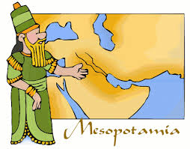
Ch. 4 Mesopotamia

Slide 2
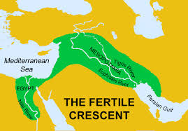
Fertile Crescent
Region of Mesopotamia between the Tigris and Euphrates rivers that is home to a large arc of rich farmland; place where civilization began

Slide 3
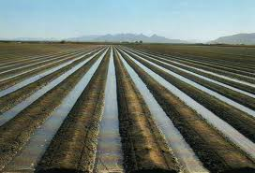
irrigation
System that supplies dry land with water through ditches, pipes, or streams

Slide 4
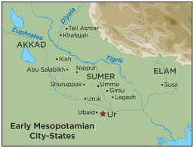
City-state
A city that governs itself and its surrounding territory

Slide 5
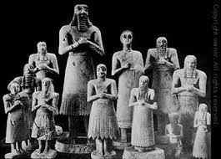
polytheism
A belief in more than one god

Slide 6
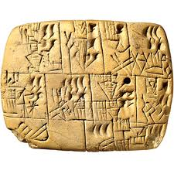
cuneiform
System of writing developed by the Sumerians that used wedged-shaped marks made in soft clay

Slide 7
scribe
A person who copies or writes out documents; often a record keeper

Slide 8
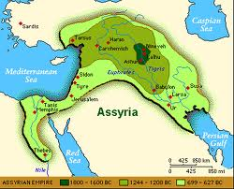
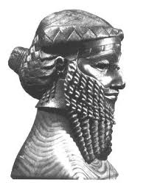
empire
Large territory or group of many territories governed by one ruler

Slide 9
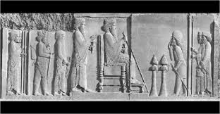
tribute
A payment made to a ruler or state as a sign of surrender

Slide 10
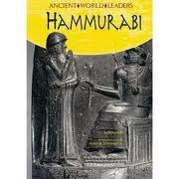
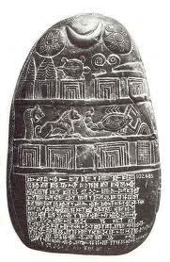
code
Set of official laws

Slide 11
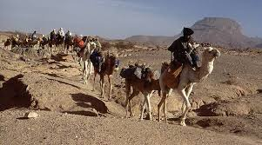
caravan
Group of merchants traveling together for safety, usually with a large number of camels

