Slide 1
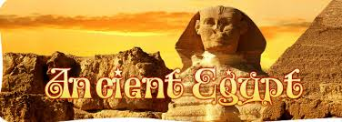
Ancient Egypt
Chapter Five

Slide 2
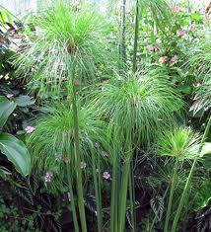
papyrus
a reed plant that grew wild along the Nile

Slide 3
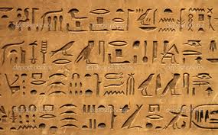
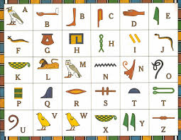
hieroglyphics
Egyptian writing system made up of a combination of pictures and sound symbols

Slide 4
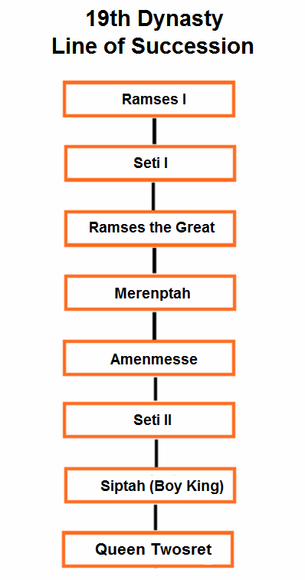
dynasty
a line of rulers from one family

Slide 5
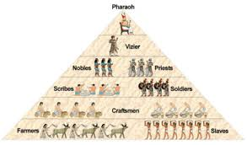
theocracy
government by religious leaders

Slide 6
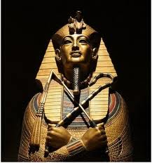
pharoah
ruler of ancient Egypt

Slide 7
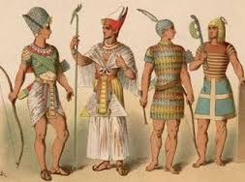
bureaucrats
government officials

Slide 8
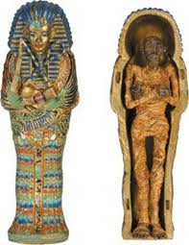
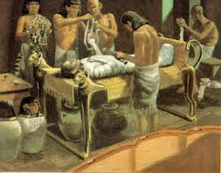
embalming
the process of treating a body to keep it from decaying

Slide 9
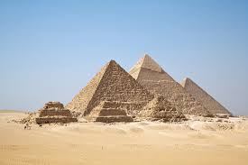
pyramids
great stone tombs built for the Egyptian pharoahs

Slide 10
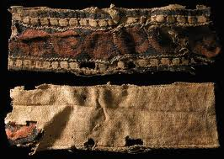
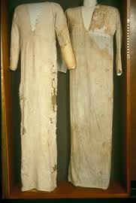
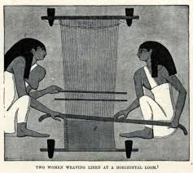
textiles
woven cloth

Slide 11
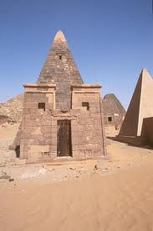
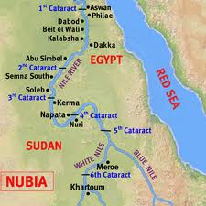
Nubia
African civilization, later known as Kush, characterized by grassy plains called savannas that challenged government for land and power

