Slide 1
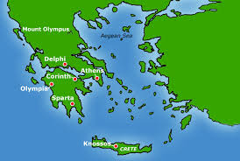
Ancient Greece
Chapter 7

Slide 2
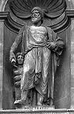
tyrant
An absolute ruler unrestrained by law

Slide 3
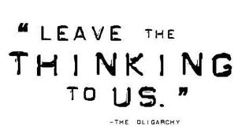
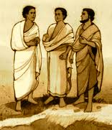
oligarchy
Government in which a small group has control

Slide 4
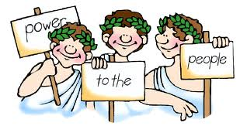
democracy
Government by the people
Direct: all citizens vote
Representative: citizens elect officials to decide on their behalf

Slide 5
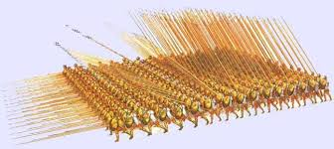
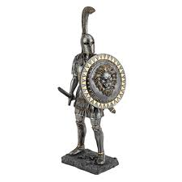
military
Relating to soldiers, arms, or war

Slide 6
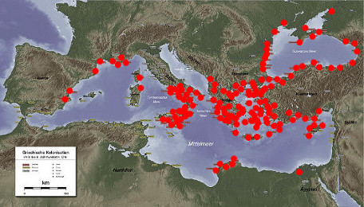
colony
A settlement in a new territory that had close ties to its homeland

Slide 7
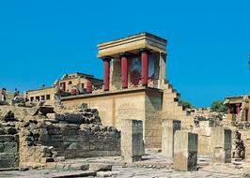
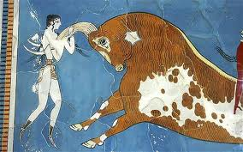
Crete
island southeast of the Greek mainland that was home to the legendary King Minos

Slide 8
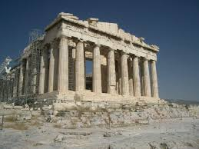
Athens
Democractic Greek city-state descended from the Mycenaeans that stressed education

Slide 9
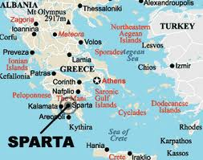
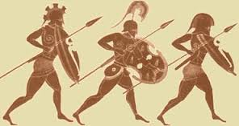
Sparta
militaristic Greek city-state that prepared all boys for a life of war

Slide 10
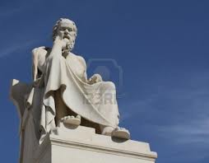
philosopher
Person who searches for wisdom or enlightenment

Slide 11
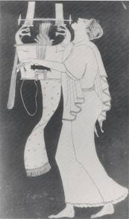
bard
Someone who writes or performs epic poems about heroes and their deeds

