Slide 1
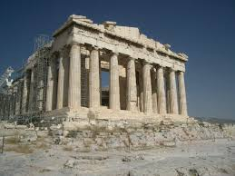
Ancient Greece Chapter 8

Slide 2
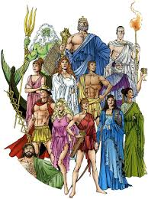
myth
Traditional story that explains the practices or beliefs of a people

Slide 3
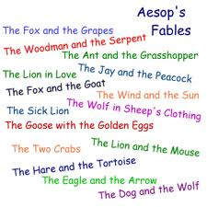
fable
Short tale meant to teach a lesson

Slide 4
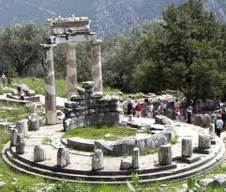
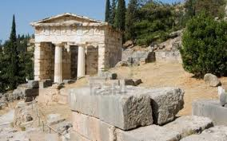
oracle
Ssacred shrine where a priest or priestess spoke to the gods

Slide 5
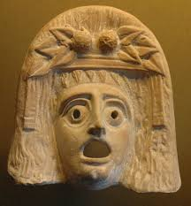
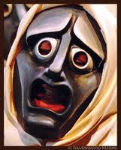
tragedy
Drama where the main character struggles to overcome hardships fails

Slide 6
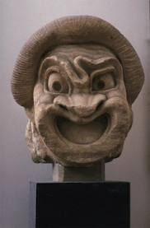
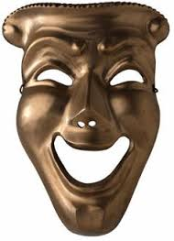
comedy
Story that ends happily and involves humor

Slide 7
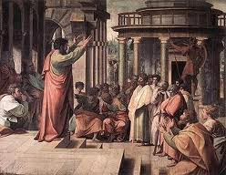
rhetoric
The art of public speaking or debate

Slide 8
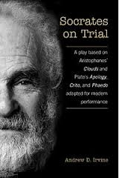
treason
Crime against the state that threatens the stability of government

Slide 9
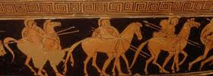
cavalry
Soldiers on horseback

Slide 10
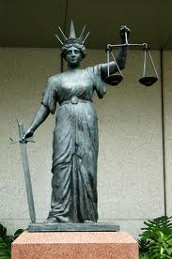
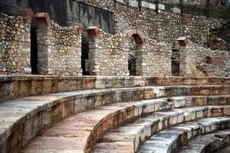
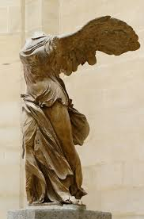
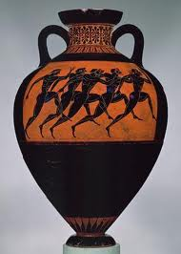
Hellenistic
“Like the Greeks”

Slide 11
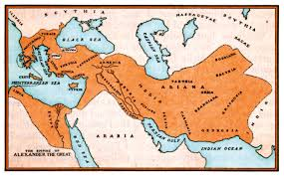
legacy
Anything handed down from the past

