Slide 1
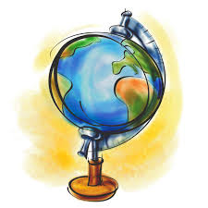
Geography Vocabulary #1
Test will be on Wednesday, August 28th

Slide 2
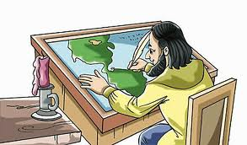
cartographer
A mapmaker

Slide 3
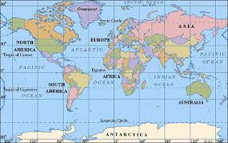
map
A drawing, chart, or other picture that shows a certain place and its features

Slide 4
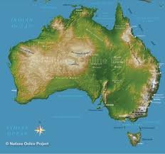
topographical map
A map that shows the physical features of a place such as mountains, lakes, rivers, etc.

Slide 5
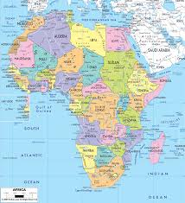
political map
A map that shows human governmental constructs such as roads, cities, and countries

Slide 6
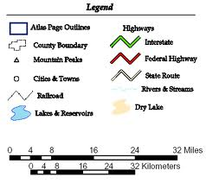
legend
A map’s key

Slide 7
symbol
A picture or mark that represents something else

Slide 8
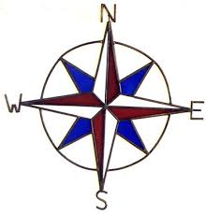
compass rose
The symbol on a map that shows the directions north, south, east, and west

Slide 9
scale
Proportion on a map that shows actual distance.

Slide 10
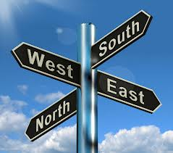
direction
North, south, east, or west

Slide 11
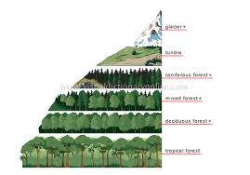
elevation
How high a place is from sea level

Slide 12
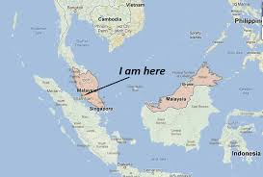
location
Position in space

Slide 13
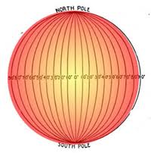
longitude
Distance east or west of the prime meridian; vertical line on a globe

Slide 14
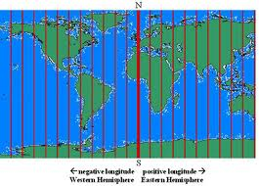
meridian
Line of longitude; great circle of the earth passing through both poles

Slide 15
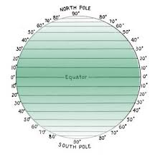
latitude
Distance north or south of the equator, horizontal line on the globe

Slide 16
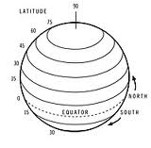
parallel
Line of latitude; an imaginary circle on the earth's surface formed by the intersection of a plane parallel to the plane of the equator

Slide 17
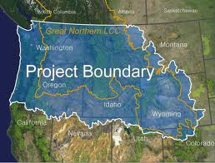
boundary
Line marking a limit on a map

Slide 18
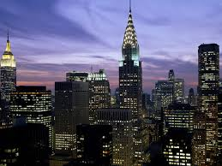
city
Population larger than a town but smaller than a county

Slide 19
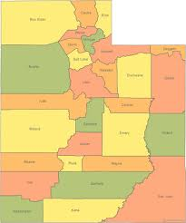
county
Group of cities

Slide 20
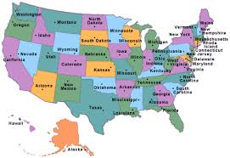
state
A sovereign political power

Slide 21
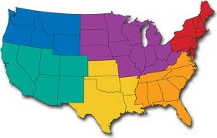
region
Territory without distinct boundaries

Slide 22
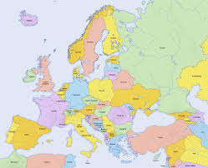
country
Whole land of a nation

Slide 23
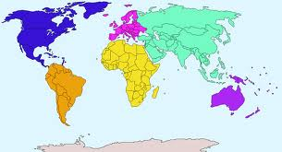
continent
One of the 7 major land masses that make up Earth

Slide 24
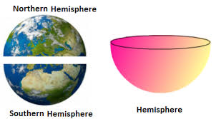
hemisphere
Half of Earth

Slide 25
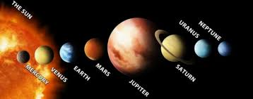
planet
Any of the 8 large celestial bodies that orbit the sun: Mercury, Venus, Earth, Mars, Jupiter, Saturn, Uranus, or Neptune

