Slide 1
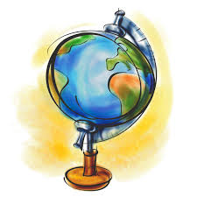
Geography Terms #2
Test on Thursday, September 4th

Slide 2
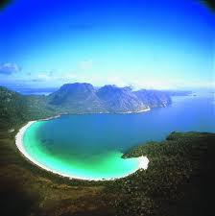
bay
Part of a large body of water that extends into a shoreline; smaller than a gulf

Slide 3
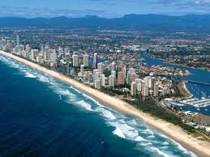
coast
Land lying next to a sea or ocean; beach

Slide 4
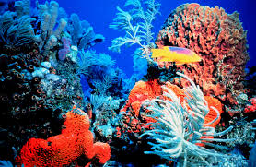
coral reef
A mound or ridge of living coral that is found in shallow sea waters; habitat for fish

Slide 5
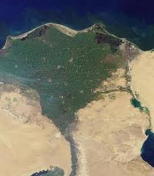
delta
Flat, low-lying land built up from soil carried downstream by a river and deposited at its mouth

Slide 6
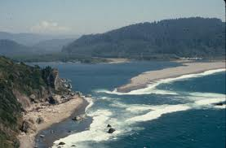
estuary
Where fresh water mixes with sea water

Slide 7
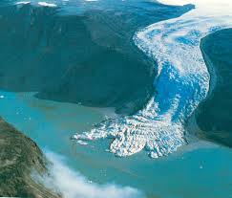
glacier
Large, thick body of slowly moving ice

Slide 8
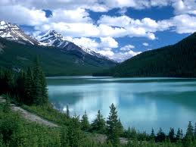
lake
A sizable inland body of water

Slide 9
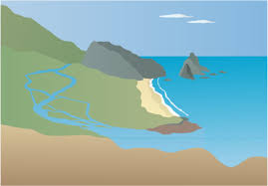
mouth
Place where a stream or river flows into a larger body of water

Slide 10
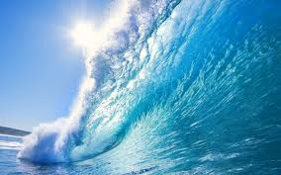
ocean
One of the four major bodies of salt water that surround the continents

Slide 11
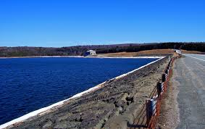
reservoir
A natural or artificial lake used for the storage of water

Slide 12
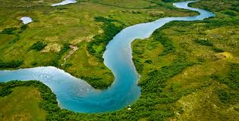
river
Large natural stream of water that runs through the land

Slide 13
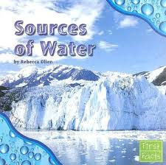
source
Place where a river or stream begins, often in highlands

Slide 14
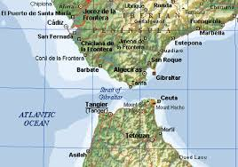
strait
Narrow stretch of water joining two larger bodies of water

Slide 15
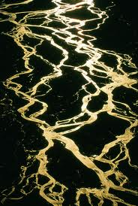
tributary
Small river or stream that flows into a large river or stream; a branch of the river

Slide 16
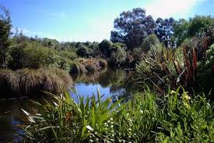
wetland
Swampy or marshy land

Slide 17
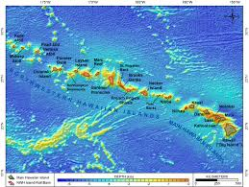
archipelago
A group of islands

Slide 18
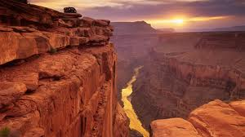
canyon
deep and narrow valley with steep walls

Slide 19
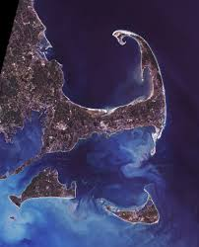
cape
Point of land that extends into a river, lake, or ocean

Slide 20
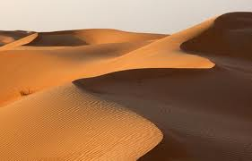
desert
Arid region with very little rainfall

Slide 21
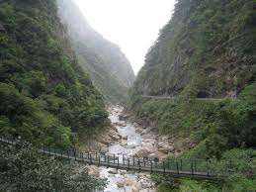
gorge
A steep canyon with a river flowing through it

Slide 22
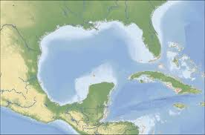
gulf
A large bay surrounded by land on three sides

Slide 23
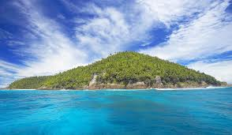
island
Land area, smaller than a continent, completely surrounded by water

Slide 24
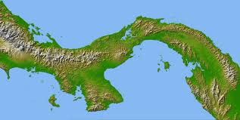
isthmus
Narrow stretch of land connecting two larger land areas

Slide 25
mountain
Land with steep sides that rises sharply from surrounding land

Slide 26
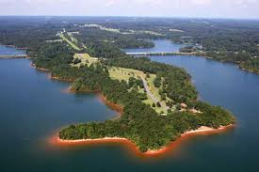
peninsula
An area of land surrounded by water on three sides

Slide 27
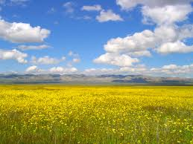
plain
Flatland, prairie

Slide 28
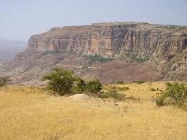
plateau
A raised area of flat land

Slide 29
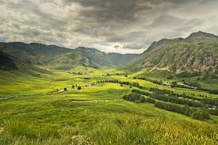
valley
A depression between hills or mountains

Slide 30
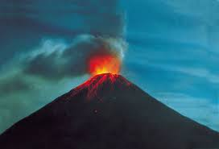
volcano
A mountain with a vent that expels molten lava or ash

