Slide 1
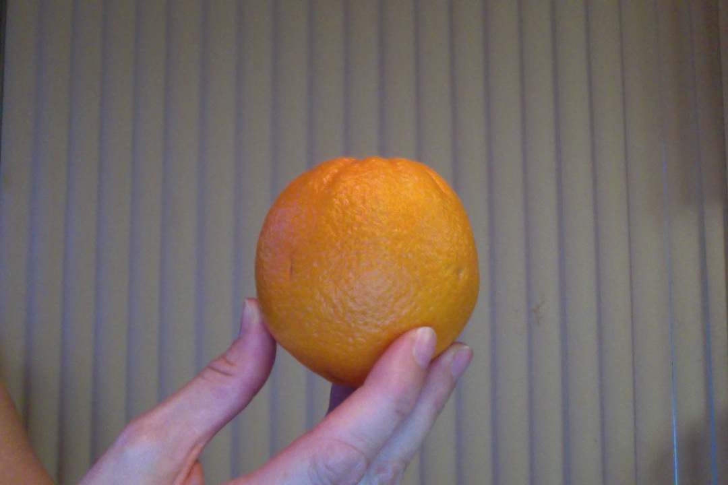
If the Earth were an Orange…

Slide 2
Equator
0 degrees latitude (horizontal)

Slide 3
Tropic of Cancer (23 * North)
Tropic of Capricorn (23 * South)

Slide 4
Lines of Latitude (Flatitudes)
Parallels (Pancakes)

Slide 5
Prime Meridian
0 degrees longitude

Slide 6
Lines of Longitude (Vertical)
Meridians

Slide 7
Lines of Longitude
Meridians (Mandarins)

Slide 8
How are they alike, and how are they different?
Equator
Prime Meridian

Slide 9
How are they alike, and how are they different?
Lines of Latitude/Parallels
SLICES
Lines of Longitude/Meridians
WEDGES

Slide 10
Hemisphere=Half of Earth
North/South
East/West

Slide 11
TRY THIS AT HOME!!!!!!

