Slide 1
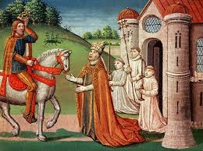
The Middle Ages Chapter 19

Slide 2
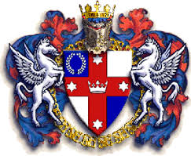
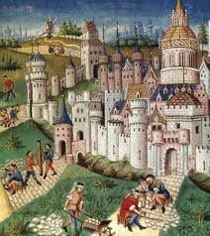
Medieval Period
The Middle Ages—lasting from approximately 500 AD to 1500 AD

Slide 3
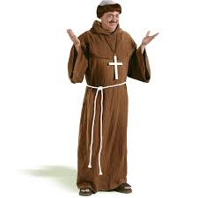
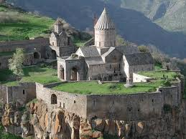
monasteries
Communities of monks, or religious men, who lived apart from society

Slide 4
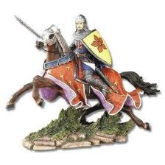
knights
Warriors who fought on horseback during the Middle Ages and practiced the code of chivalry

Slide 5
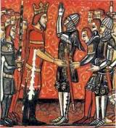
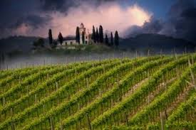
vassal
Knight who promised to support a lord in exchange for land called a fief

Slide 6
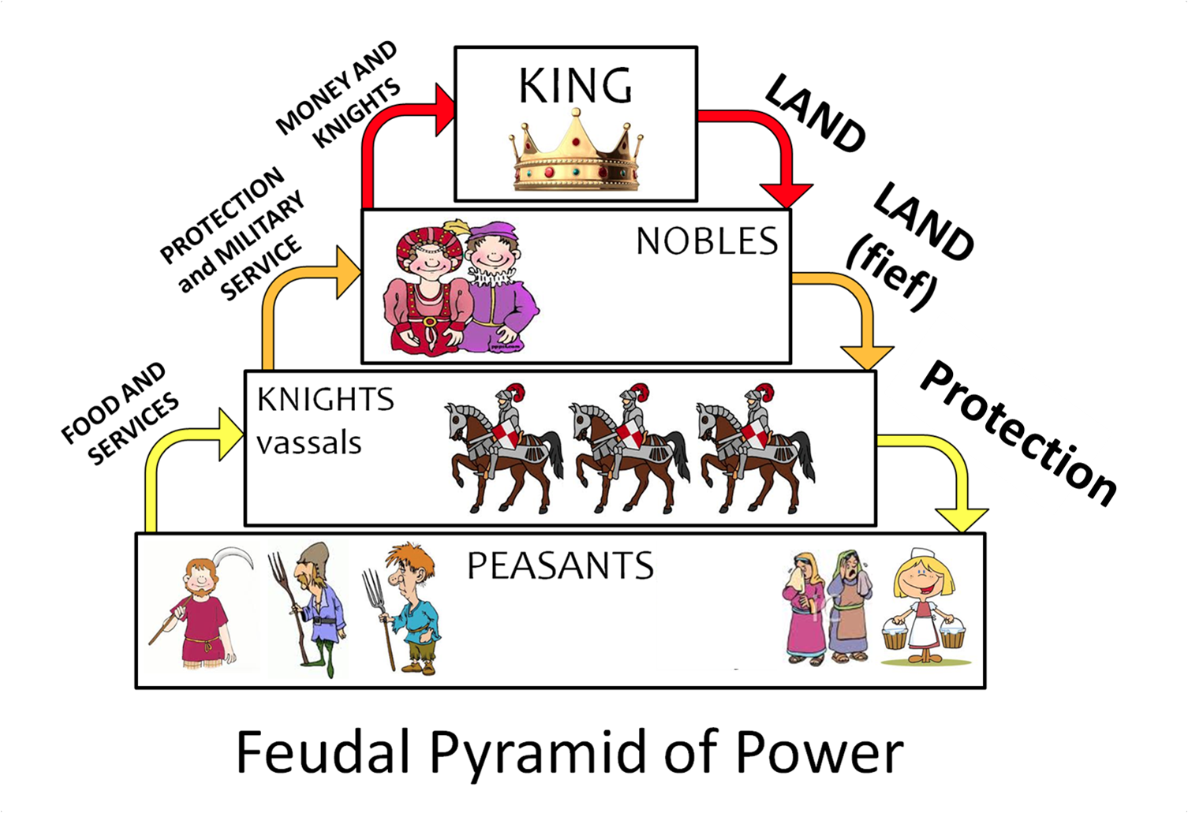
feudalism
Political and social order that governed the relationships between lords an vassals during the medieval period

Slide 7
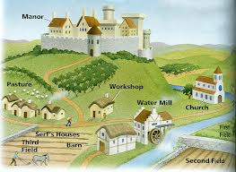
manor
Large estate owned by a knight or a lord

Slide 8
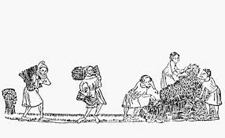
serfs
Workers who were tied to the land on which they lived

Slide 9
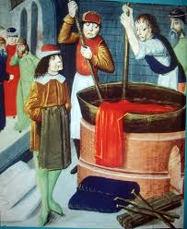
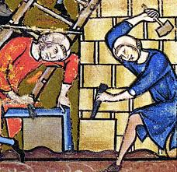
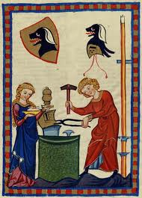
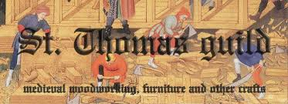
guild
A group of merchants or craftspeople that controlled business and trade in town

Slide 10
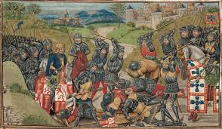
Crusades
Long series of wars between Christians and Muslims over control of Palestine, also known as the Holy Land

Slide 11
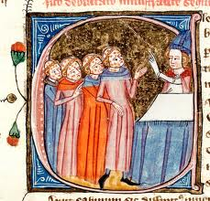
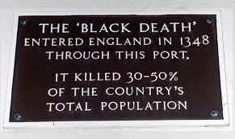
Black Death
A deadly plague that swept through Europe between 1347 and 1351

