Slide 1
Ch. 3 Early Humans

Slide 2
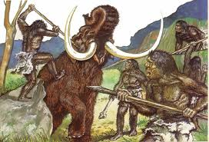
Paleolithic Age
The earliest period of the Stone Age. It lasted from 2.5 million B.C. – 8000 B.C.

Slide 3
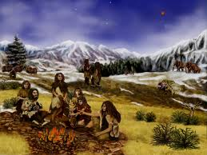
nomads
People who move from place to place as a group to find food for themselves

Slide 4
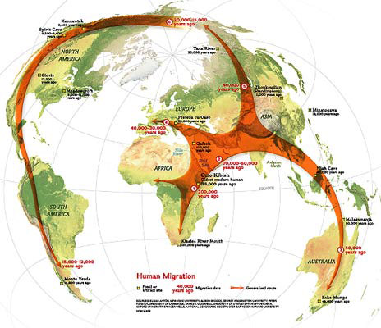
migrate
To move from one place to settle in another place

Slide 5
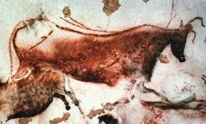
communicate
To share information with someone

Slide 6
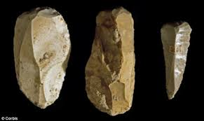
technology
Tools and methods used to perform tasks

Slide 7
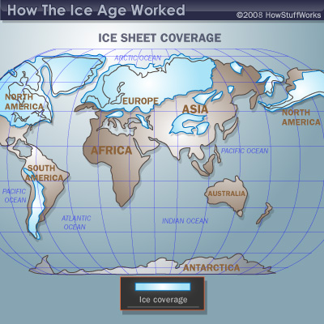
Ice ages
Long periods of extreme cold that affected all of Earth

Slide 8
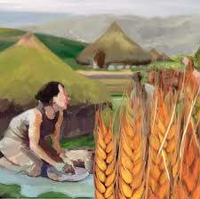
Neolithic Age
The period from 8000 B.C. – 4000 B.C. when humans shifted from hunting and gathering societies to farming societies

Slide 9
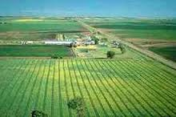
systematic agriculture
Growing food on a regular basis

Slide 10
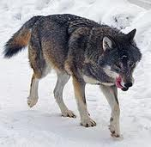
domesticate
To tame animals for human use

Slide 11
Bronze Age
Period from 3000 B.C. to 1200 B.C. when people began to make and use bronze

Slide 12
society
Community of people who share a common culture

