Slide 1
World Religions

Slide 2
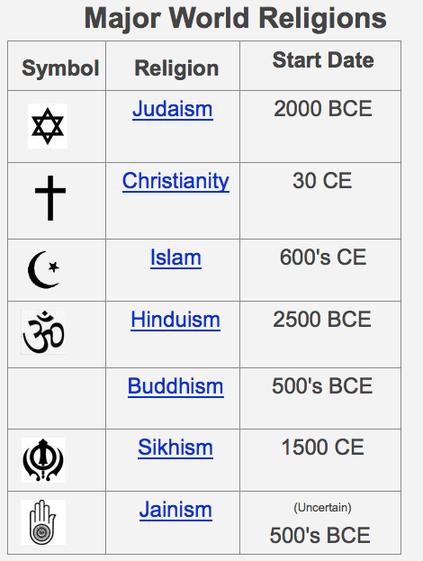

Slide 3
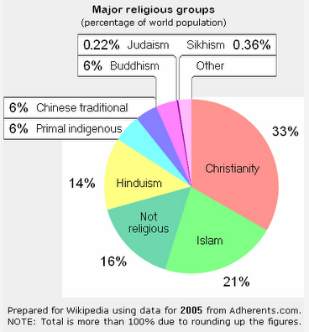

Slide 4
Judaism

Slide 5
Judaism
Judaism is around 3500 years old.
It is one of the oldest of the world's monotheistic religions—religions with only one god.
It's also the smallest, with only about 12 million followers around the world.
Jerusalem is their most holy city and the capital of Israel—the only nation where Jewish people are the majority of the population.
In ancient times Jewish people were called Hebrews or Israelites.

Slide 6
People of Judaism
Abraham is believed to be the father of the Jewish people.
The story of Abraham is told in the Torah or what Christians call the Old Testament.
The most important person in Judaism is Moses.
According to the Torah, Moses is the leader who freed the Jews from slavery in Egypt. However, there is no written evidence of this enslavement story in Egyptian writing.
According to Jewish writing, when Moses and the Hebrews left Egypt they traveled through the Sinai Peninsula. One night he climbed Mount Sinai.
It is believe that God gave him the 10 Commandments that eventually became part of the Old Testament. The 10 Commandments provided the Jewish people guidelines of how to live their lives.

Slide 7
Place of Worship
The Jewish word for god is Yahweh.
Jews worship in synagogues. Men and women usually sit separately in the synagogues. Men are required to cover their heads with a hat called a yarmulke (yam-moo-ka).
In most cases, worship takes place in the Hebrew language.
The Jewish spiritual leaders are called rabbis.
Unlike leaders in many other faiths, a rabbi is not a priest and has no special connection with god.
Jewish holy books mainly talk about life on Earth, and rarely mention anything similar to an afterlife.

Slide 8
Food
Part of Jewish life revolves around eating the correct food.
Kosher foods are those that follow Jewish law. This means no mixing of dairy and meat, no pork or pork products and no shellfish.
Jews can eat meat from any animal that chews its cud and has a split hoof such as cows, goats, and sheep—rabbit, pig, horse, dog, and cat are not kosher.
Jews may eat fish that have both fins and scales that are detachable from the skin.

Slide 9
Jewish Teachings
There are different levels and types of belief or different denominations such as Orthodox, Reform, and Liberal Jewish faiths.
Traditionally, Jews say prayers three times daily, with a fourth prayer added on holidays.
The Old Testament says the "Messiah" will come to Earth and save the Jewish people.
Jesus was born into the Jewish religion. There were certain things about Judaism that he thought were wrong, so he began preaching new ideas. He was thought of as a rebel preacher, however some people thought he was the Messiah.
After Jesus was killed, his followers went on to start a new religion called Christianity. That is why Christianity and Judaism share religious writing, characters, and beliefs.
The confusing thing about being Jewish is that it is more than just a religion. It is also an ethnic group. People can be Jewish even if they don’t follow the religion. According to traditional Jewish Law, a Jew is anyone born of at least one Jewish parent OR someone who has converted to the religion of Judaism.

Slide 10
Holidays and Celebrations
There are special ceremonies when Jewish boys (aged 13) and girls (aged 12) become adults. Bar mitzvah is for boys and Bat mitzvah is for girls.
Yom Kippur is the most important Jewish holiday. Jews traditionally observe this holiday with a 25-hour period of fasting and intensive prayer, often spending most of the day in synagogue.

Slide 12
Christianity

Slide 13
Christianity
Christianity is the world’s biggest religion, with about 2.2 billion followers worldwide.
The religion is a monotheistic religion that is based on the teaching of Jesus of Nazareth who later became known as Jesus Christ.
Jesus’ believers believe he is the Son of God.
Jesus was crucified around 33 AD in Jerusalem, during the Roman Empire.
Old Jewish writings said a leader would die and rise form the dead to lead the people.

Slide 14
People of Christianity
Apostles played an important part in the growth of Christianity.
Peter and Paul were two important apostles in the early Christian church.
Peter was a Jewish fisher from Galilee. He had known Jesus while he was alive AND helped set up a Christian church in Rome after the death of Jesus.
Paul of Tarsus was another important Christian apostle. He was a well-educated Jew and a Roman citizen. He was raised as a loyal Roman who, as an adult, distrusted the Christians. Saul—his Hebrew name—at first tried to stop Christian ideas from spreading in Judaea and Galilee
Paul soon became a Christian and devoted his life to spreading the message of Jesus.
Paul traveled throughout the eastern Mediterranean region and founded numerous Christian churches. Many of his important letters to churches in Rome, Greece, and Asia Minor are found in the Christian Bible.

Slide 15
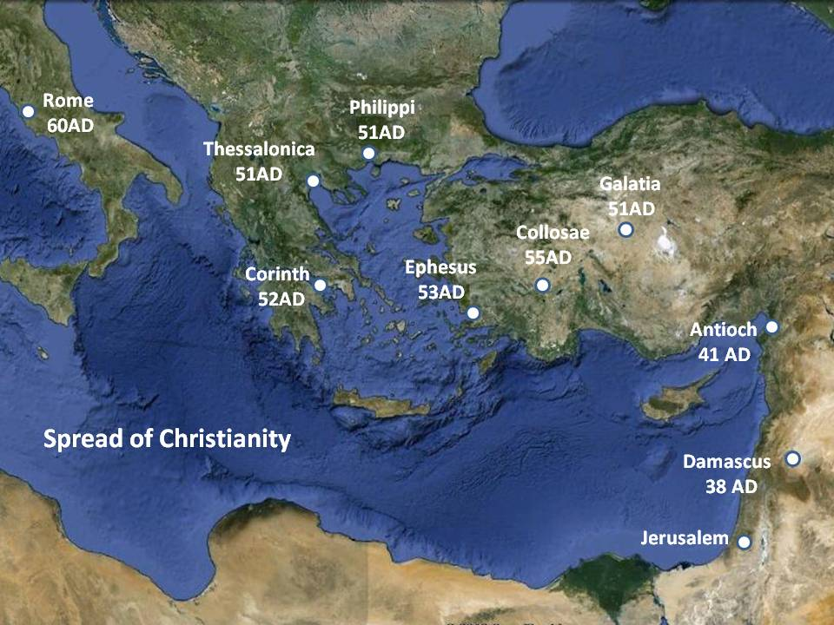
Spread of Christianity

Slide 16
Place of Worship
The Christian place of worship is called a church.
They are often built in the shape of a cross with the altar facing east towards the rising sun.
Christian spiritual leaders are called priests or ministers.
The Bible is the Christian holy book. It is divided into the Old Testament (Jewish book) written before Jesus and New Testaments.

Slide 17
Teachings
Christians believe Jesus rose from the dead and appeared to his disciples (followers) which made him Messiah (Savior) promised in the Old Testament.
Most people who lived in the time of Jesus did not believe he rose from the grave.
Today, Jews are awaiting the coming of a Messiah or Savior, while Christians believe that Jesus Christ was the Savior.
Christianity didn’t just happen immediately. For nearly 100 years Christianity was a denomination of Judaism, and a very unpopular one at that.
Jesus preached new ideas that many Jews and Romans viewed as rebellious--it was dangerous to be a follower of Jesus.
The number of followers greatly increased when Romans began to convert to Christianity.
There are different branches or denominations of Christianity because some Christians worship in different ways and believe in different parts of the Bible.
There are 3 main denominations in Christianity--Roman Catholic, Easter Orthodox, and Protestant. Each denomination is further divided. Methodists, Mormons, Baptists, and Quakers are just a few of the dozens (maybe hundreds) of Christian denominations.
They all worship in different ways, different times of the day, saying different prayers, and believing different things, but most believe in certain core ideas such as heaven, and the resurrection of Jesus.

Slide 18
Holidays and Celebrations
The most important Christian holiday for all Christians is Easter, which celebrates the resurrection of Jesus.
Other holidays include Christmas, Lent and Good Friday

Slide 19
Islam

Slide 20
Islam
Islam, another monotheistic religion, is the second most popular religion in the world with over a billion followers.
A Muslim is a follower of Islam.
This religion began about 600 years after Christianity.
The prophet Muhammad is the founder of Islam, and Muslims believe he was the last prophet of Allah or God.
This message was written down in a book called the Koran.
Islam began in modern-day Saudi Arabia in a town called Mecca where Muhammad was born.

Slide 21
People
The prophet Muhammad is the founder of Islam, and Muslims believe he was the last prophet of Allah—it is believed the first prophet was Adam (Adam and Eve).
There were many prophets before Muhammad including: Adam, Noah, Abraham, Job, Moses, John the Baptist, and Jesus.
Muslims do not think of Muhammad as the founder of a new religion, but as the restorer of the original monotheistic faith of Abraham, Moses, Jesus, and other prophets. Muslims believe that Jews and Christians have distorted the original message of God.

Slide 22
Place of Worship
The Muslim place of worship is called a mosque
Very often mosques have a domed roof and at least one tall tower called a minaret.
Muslims are called to prayer from the minaret.
There is also very little furniture inside a mosque because Muslims use “prayer mats” to kneel on when they pray. Muslims are supposed to pray 5 times every day.
When people go into the mosque they take off their shoes. This is to keep it clean for prayer.
Women do not usually pray in the same place as men.

Slide 23
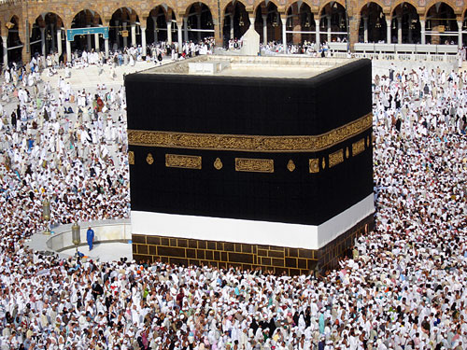
Holidays and Celebrations
There are two official holidays in Islam: Eid Al-Fitr and Eid Al-Adha
Eid Al-Fitr is celebrated at the end of Ramadan (a month of fasting), and Muslims usually give zakat (charity) on the occasion.
Eid Al-Adha is celebrated on the 10th day of Dhu al-Hijjah and lasts for four days where Muslims usually sacrifice an animal and distribute its meat among family, friends and the poor.

Slide 24
Teachings
Muslims do not have priests; they don’t believe they need a “middleman” between themselves and Allah (God).
An Imam (i-mom) leads local prayer and takes care of the mosque.
Similar to Christians, Muslims believe in afterlife.
There are 2 major denominations in Islam—Sunni (soon-ee) and Shi’a (she-ah).
Almost 90% of Muslims are Sunnis.
The Shi’a split from the Sunnis in 632 CE when Muhammad died. They disagree about who should lead Islam and how they should be chosen.
Another very important part of Islam is the 5 Pillars of Islam—similar to the 10 Commandments of Judaism and Christianity.
These are 5 things required of all believers of Islam. They are:
1. Shahadah--is a statement of belief in monotheism and accepting Muhammad as God's messenger.
2. Salah--the requirement to pray 5 times a day at dawn, noon, mid-afternoon, sunset, and night.
3. Zakat--is the practice of giving to charity; about 3 percent of your individual wealth.
4. Sawm--Muslims must abstain from food and drink from dawn to dusk during the month of Ramadan
5. Hajj--expectation to make a pilgrimage to Mecca at least once in their lifetime if they can afford it.

Slide 25
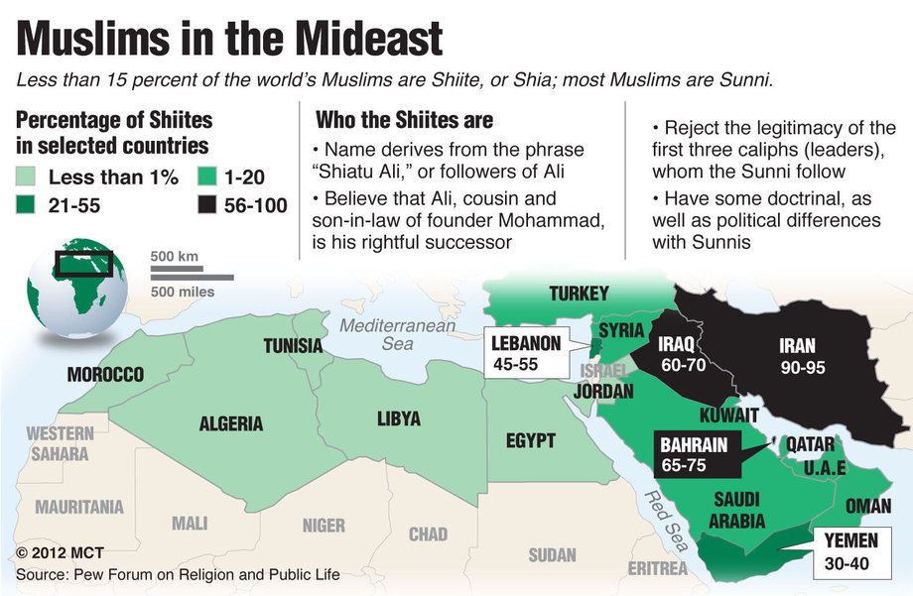

Slide 26
Hinduism

Slide 27
Hinduism
Hinduism is considered to be the oldest “living” religion in the world, since it began at least four thousand years ago and people still follow it today.
What we call Hinduism is a huge collection of belief systems that have been influenced and changed over history.
Hinduism is the third largest religion in the world, with about 1 billion followers world-wide, most of whom live in India.
Hinduism provided the belief structure for all other South Asian religions that followed such as Buddhism, Sikhism, and Jainism. Just as Judaism provided the structure for Christianity and Islam.

Slide 28
People
Unlike most other major religions, Hinduism has no single founder like Jesus or Mohammad or a central leader like the Pope—because of this, people worship in VERY different ways.

Slide 29
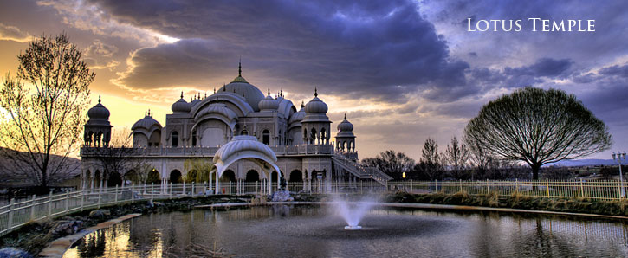
Place of Worship
Daily worship in Hinduism usually takes place in three different places.
In the home, in a temple, and/or at a street-side or road-side shrine.
Most Hindu households have a small shrine to the gods important to that house. A nearby temple to a god or goddess is usually the focus of regular worship but a grander cathedral-like, temple may be visited on special occasions.

Slide 30
Teachings
Most Hindus believe in one supreme spirit called Brahman. Hindus believe God is all things in the world—not just a spirit in the sky.
Brahman does not just exist; it IS existence.
Brahman can be worshiped in many forms, such as other “gods” such as Vishnu, Shiva, Ganesh or Krishna, so many people think Hindus worship many gods, but actually all other gods represent Brahman in different forms.
Most Hindus believe in reincarnation (rebirth of the soul)—the belief that when the body dies, the spirit is reincarnated (reborn) into a new form.
The soul may be reborn in many different forms such as another human or an insect.
What they are reborn as depends on their karma.
Karma is the belief that everything that people do in life determines what will happen to them in the future.
If a person follows the dharma (a life path of truth, duty, religion and good behavior) he or she can expect to be reincarnated into a higher form in their next life, or have good luck in the future.
The ultimate goal for Hindus is to end their reincarnation cycle and reach Moksha. Moksha is a “one-ness” with God.
To followers of Hinduism some water is sacred. The river Ganges in northern India is Hinduism's most holy river. Hindu's personify the Ganges River with the goddess Gaṅgā. They believe that bathing in the Ganges helps to wash away sin and move toward Moksha. When most Hindu's die, they cremate (burn) the body. Sometimes the ashes are put into the Ganges.

Slide 31
Holidays and Celebrations
Major festivals likely to be observed by most Hindus are:
Holi- festival of colors and spring (February-March)
Mahashivaratri (Shiva Ratri) - night sacred to Shiva (February-March)
Rama Navami - birthday of Lord Rama (April)
Krishna Jayanti - birthday of Lord Krishna (July-August)
Raksābandhana - renewing bonds between brothers and sisters (July-August)
Kumbh Mela - pilgrimage every 12 years to four cities in India (July-August; last one 2003)
Ganesha-Chaturthi (Ganesha Utsava) - festival of Ganesh (August-September)
Dassera - victory of Rama over demon king Ravana (September-October)
Navaratri - festival of Shakti (in Bengal) or Rama's victory over Ravana (South India) (September-October)
Diwali- festival of lights and Laksmi (September-October)

Slide 32
Reincarnation
Bathing in the Ganges River

Slide 33
Buddhism

Slide 34
Buddhism
With as many as 500 million followers, Buddhism is the 4th largest religion in the world
Buddhism focuses on the teachings of Siddhartha Gautama.
Buddhism is a religion that is not based on the idea of God—it’s more of a way of life, so it is actually a philosophy, but most people still call Buddhism a religion
A “Buddha” is a person who discovers the true understanding of life through years of spiritual investigation and studying using meditation.
There have been several Buddhas, but Siddhartha was THE Buddha.
Buddhists respect all life and encourage nonviolence and kindness.
Buddhism encourages its followers to reach enlightenment which is an understanding the true meaning of life and truth about the world.

Slide 35
People of Buddhism
Buddhism focuses on the teachings of Siddhartha Gautama.
Siddhartha was born a Hindu, but had a difficult time believing the teachings because of all of the suffering he saw in the world.
Siddhartha was born a wealthy prince, but gave up everything to find a true understanding of the world.
He tried many different types of Hindu beliefs, but eventually he formed his own belief system and taught many others.
He was called “The Buddha”, or the enlightened one.
His teachings were written in Buddhist holy books called Tripitaka or Sutras.

Slide 36
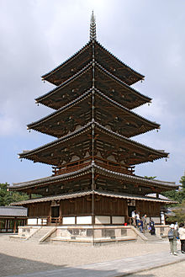
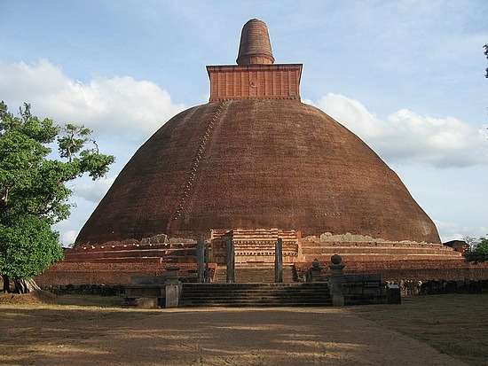
Place of Worship
Buddhists do not require a special building to worship, although there are two main types of Buddhist temples: Pagodas and stupas.
A stupa is a mound-like structure that often has a Buddhist relic buried underneath.
A pagoda is a temple usually found in China and Japan with several tiers or levels.
Buddhist worship is called puja. It involves meditation, bowing, chanting, or making offerings--depending on the region.

Slide 37
Teachings
Today, there are two main types of Buddhism: Theravada and Mahayana.
Theravada is more traditional--they accept fewer historical people as true Buddhas and include fewer local adaptations.
Mahayana history was built along the Silk Road, adapting new ideas, people, and cultures changes.
All Buddhists, especially Theravada wish to achieve the end of suffering (Nirvana). To do this, Buddhists must train and purify their mind by following the Four Noble Truths.
The Four Noble Truths are:
1—Life is suffering
2—Suffering is due to attachment to things.
3—Attachment can be overcome.
4—There is a life path to accomplish all of this The "path" mentioned in the 4th Noble Truth is called the Noble Eightfold Path. It is meant to focus the mind and behavior of Buddhists and help them reach Nirvana.

