Slide 1
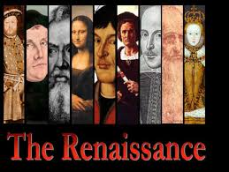
Renaissance & Reformation

Slide 2
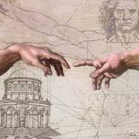
Renaissance
Europe’s “rebirth” of learning…it began in Italy in about 1350 AD. It was a time period marked by extensive trade and advances in art and literature

Slide 3
secular
Related to worldly things, separate from religion

Slide 4
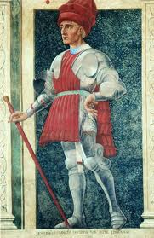
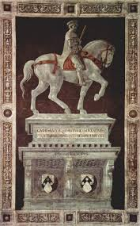
mercenary
A full-time soldier who fights in an army for money

Slide 5
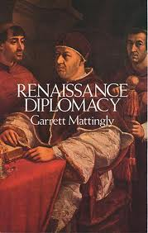
diplomacy
The practice of conducting negotiations between countries

Slide 6
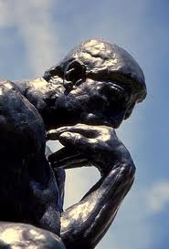
humanism
A new way of understanding the world based on Greek and Roman ideals which encouraged individuals to gain knowledge through reason, not religious faith

Slide 7
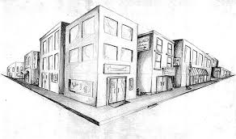
perspective
A realistic way of drawing that shows depth and dimension

Slide 8
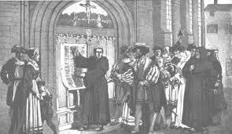
Reformation
A religious movement that produced a new form of Christianity known as Protestantism

Slide 9
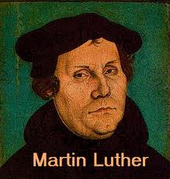
Martin Luther
a German Catholic monk that became angry with Church practices and beliefs. He wrote the Ninety-Five Theses and created the first Protestant Church called Lutheranism.

Slide 10
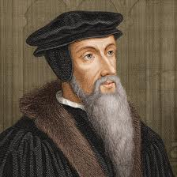
John Calvin
a French Protestant who formed his own beliefs and started another Protestant movement called Calvinism

Slide 11
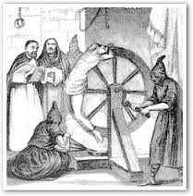
Spanish Inquisition
a religious court in Catholic Spain that sought to find and punish those guilty of heresy, which are beliefs that contradict Church teaching

