Slide 1
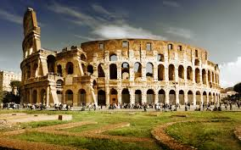
ANCIENT ROME 1 Chapters 11 & 12
500 BC – 395 AD

Slide 2
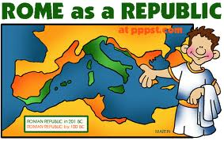
republic
A form of government in which citizens elect their leaders

Slide 3
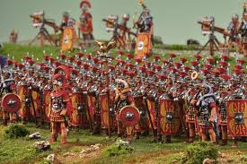
legion
A large group of Roman soldiers

Slide 4
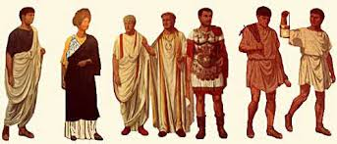
Patricians
Ruling class of Ancient Rome

Slide 5
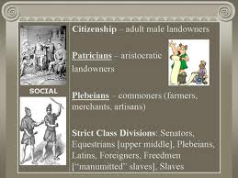
Plebeians
Commoners--ordinary citizens of Rome

Slide 6
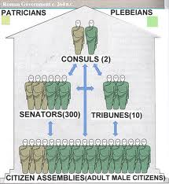
consul
Head of government, usually with a limited term in office

Slide 7
veto
To reject

Slide 8
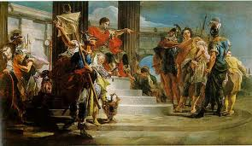
praetors
Government officials who interpret the law and serve as judges

Slide 9
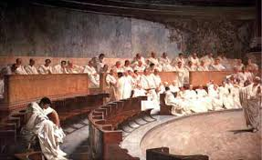
legislature
A group of people who make the laws…in Rome the legislature was called the Senate.

Slide 10
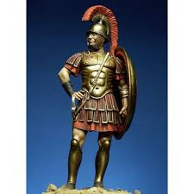
tribune
An elected official who protected the rights of ordinary citizens

Slide 11
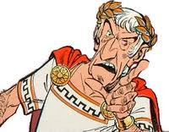
dictator
A person granted absolute power

