Slide 1
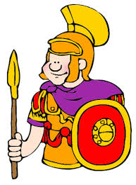
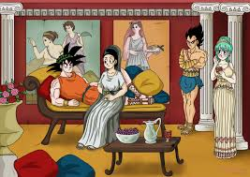
Rome 2
Chapters 11 & 12

Slide 2
aqueduct
Human-made channel that carries water long distances

Slide 3
gladiator
In Ancient Rome, a person who fought people or animals for public entertainment

Slide 4
arch
A curved part of a structure that serves as a support

Slide 5
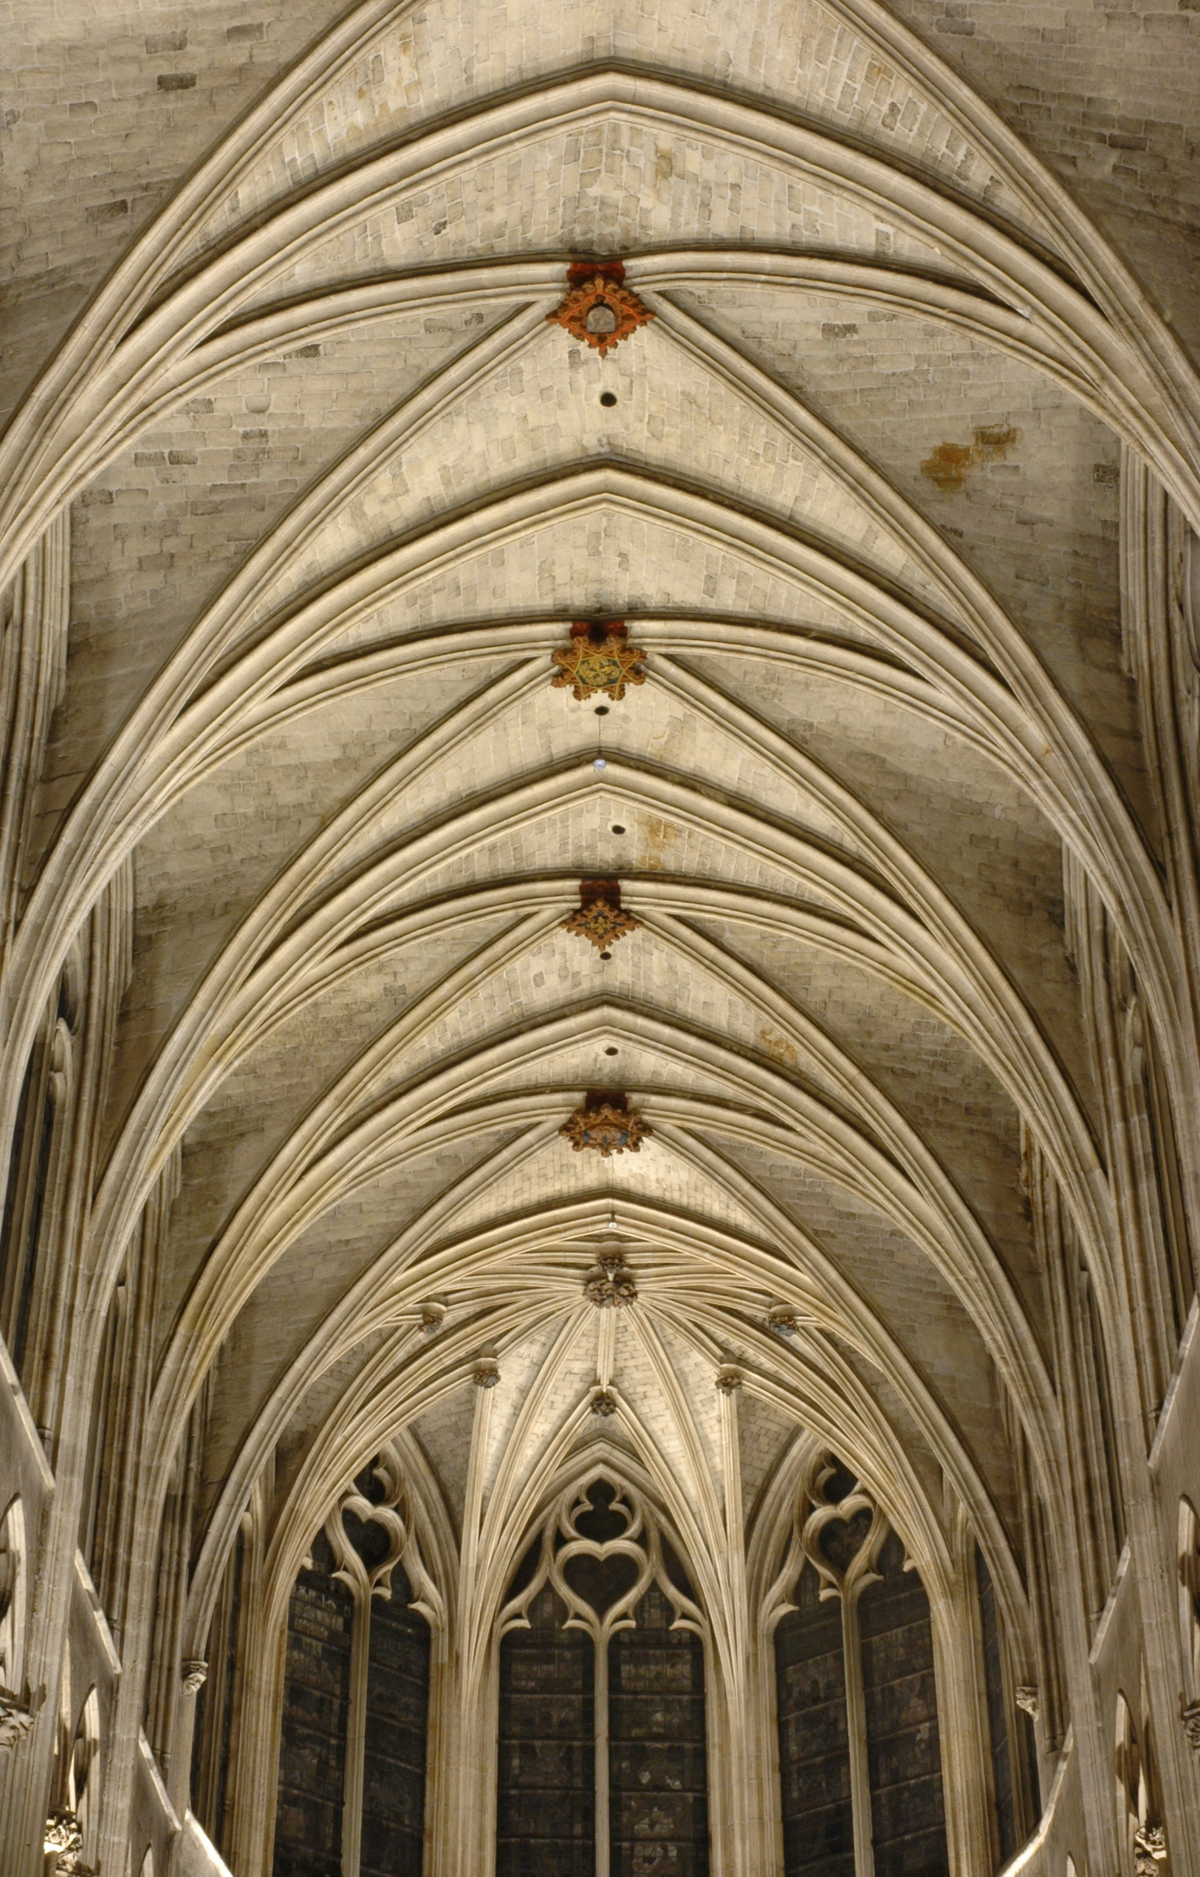
vault
Curved ceiling made of arches

Slide 6
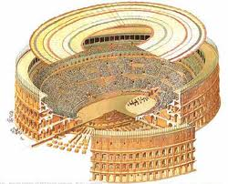
Colosseum
Huge arena located in central Rome used for public entertainment

Slide 7
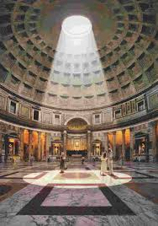
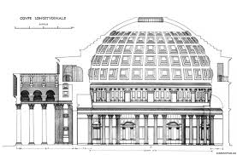
Pantheon
Roman domed temple built to honor the gods

Slide 8
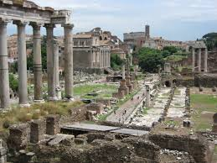
Forum
Rome’s public meeting place

Slide 9
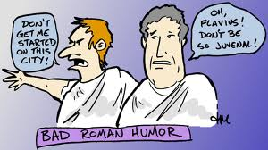
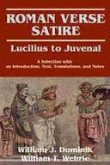
satire
Writing that pokes fun at human weaknesses which is comically sarcastic

Slide 10
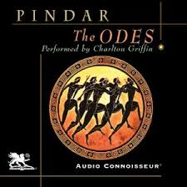
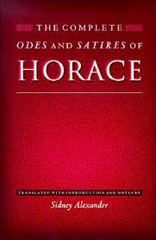
ode
Poem that expresses strong emotions about life

Slide 11
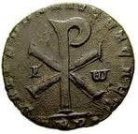
Pax Romana
Roman Peace (the first 200 years of the Roman Empire)

