Slide 1
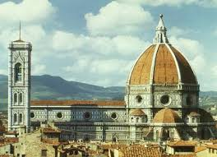
Writers and Artists of the Renaissance

Slide 2
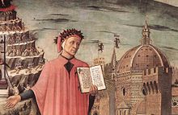
Dante Aligheri
Dante was a major Italian poet who wrote the masterpiece The Divine Comedy. It was especially significant because it was written in the Italian vernacular language, so it was accessible to the common man, not just Latin scholars. In The Divine Comedy, Dante travels through the Inferno, Purgatory, and Paradise.

Slide 3
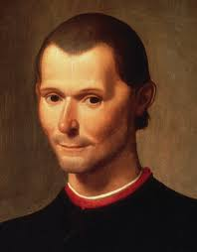
Niccolo Machiavelli
Machiavelli was a Florentine statesman and writer who is most well known for his written work entitled The Prince. The Prince describes successful rulers as ones that were decisive and sometimes ruthless in to keep order. Today, he term “Machiavellian” is often used to describe unscrupulous politicians.

Slide 4
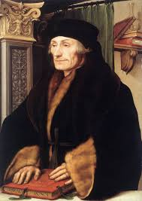
Desiderius Erasmus
Renaissance humanism led to a movement called “Christian humanism”. Erasmus was a Christian humanist who wanted to restore the simple faith of the early church. He believed people should use reason to become better Christians. Erasmus wrote a book called Praise of Folly which used humor to criticize Church corruption.

Slide 5
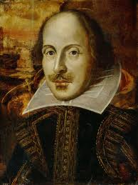
William Shakespeare
William Shakespeare was an English poet, playwright, and actor who lived in Stratford-upon-Avon during the height of the Renaissance. He is often regarded as the greatest writer in the history of the English language. His plays were performed at the Globe theater, which would display colored flags to signal the plays—black for tragedies like Romeo and Juliet, white for comedies like Midsummer’s Night Dream, and red for histories Julius Caesar.

Slide 6
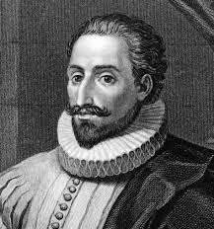
Miguel Cervantes
Miguel Cervantes was a Spanish writer wrote Don Quixote. This book, which has become a national treasure, pokes fun at the romantic tales of the Middle Ages.

Slide 7
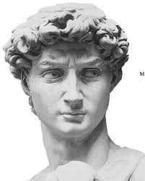
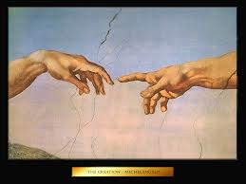
Michelangelo
Michelangelo produced some of the most famous works of art in world history. Michelangelo was a Renaissance sculptor from Florence. His masterpieces include David and the ceiling of the Vatican’s Sistine Chapel.

Slide 8
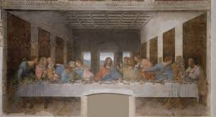
Leonardo da Vinci
The true genius of the Renaissance was Leonardo da Vinci. In addition to being an expert painter, Leonardo was a sculptor, architect, inventor, engineer, town planner, and mapmaker. Besides the masterpiece paintings Mona Lisa and Last Supper, Leonardo left notebooks full of detailed drawings of the things that interested him, including plans for a flying machine and studies of the human body.

Slide 9
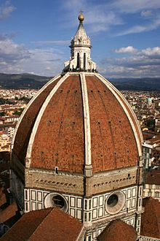
Filippo Brunelleschi
Brunelleschi was an artist who refined the concept of linear perspective, but he is most famous for his contributions to Italian architecture. He engineered the dome on the Florentine Cathedral, which still stands today.

Slide 10
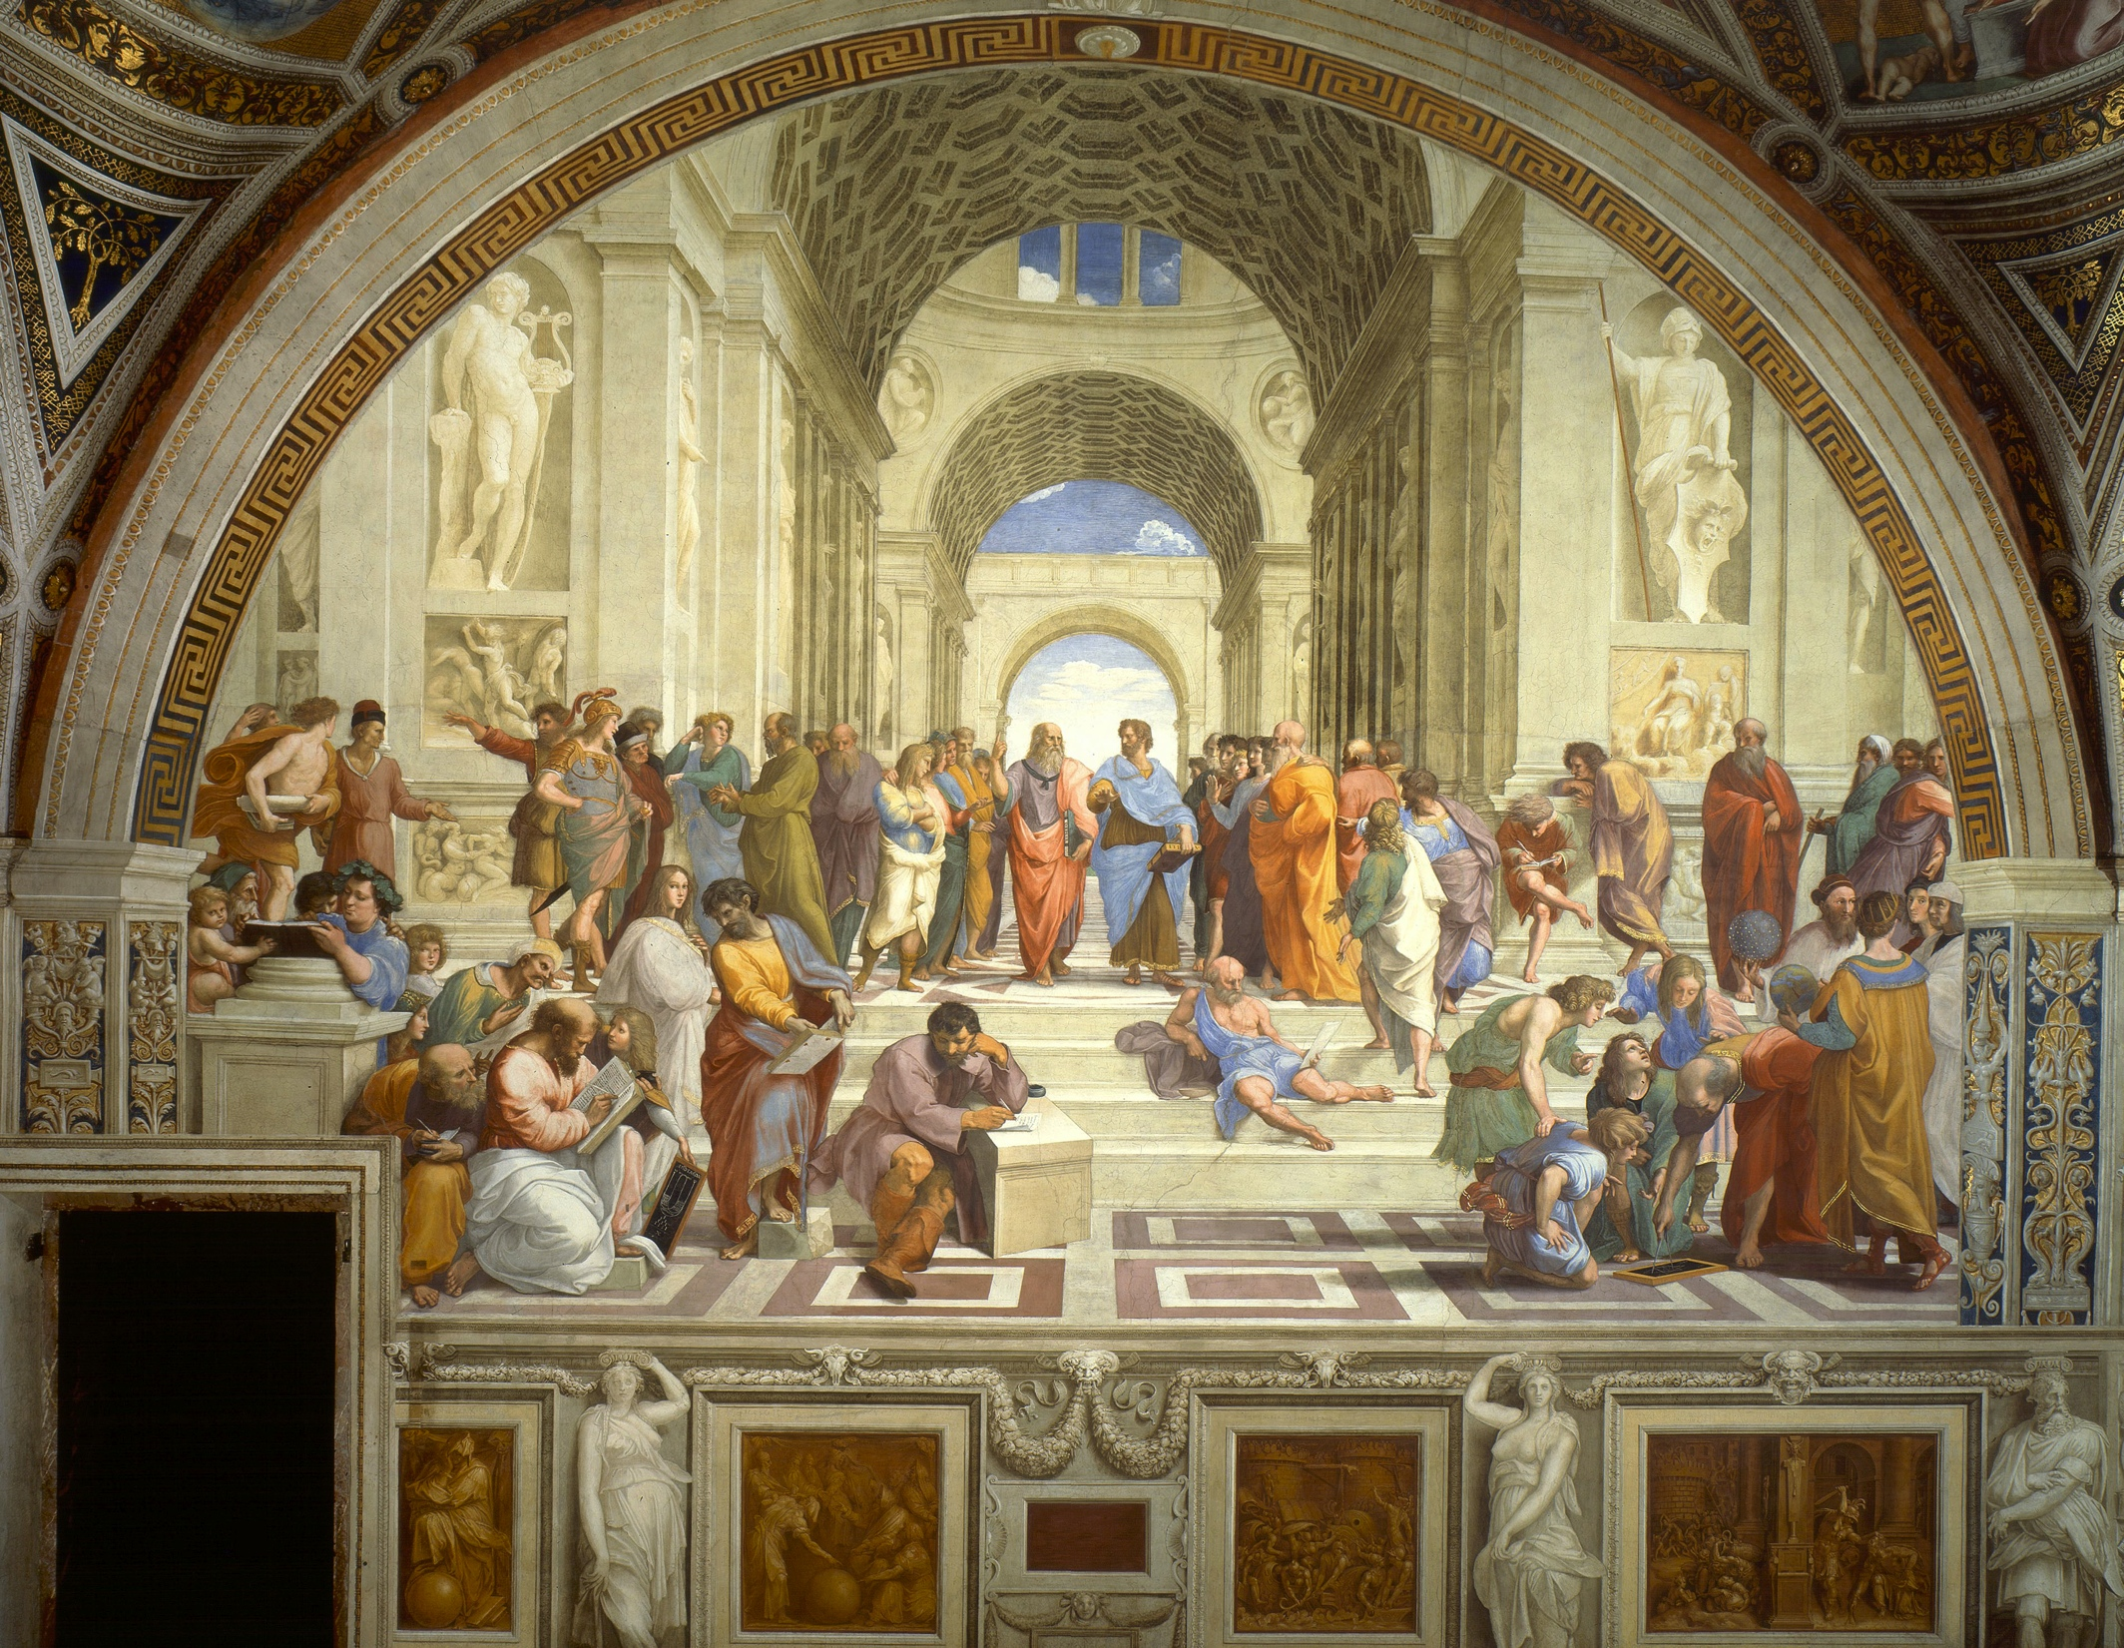
Rafael
Raphael was one of the great painters of the Renaissance who even though he died at at 37, left a large body of work. He worked in Urbino, then Florence, then Rome. Although he painted portraits, he is best known for his larger masterpieces commissioned for the Vatican.

Slide 11
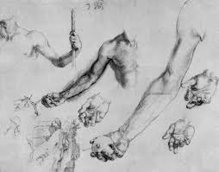
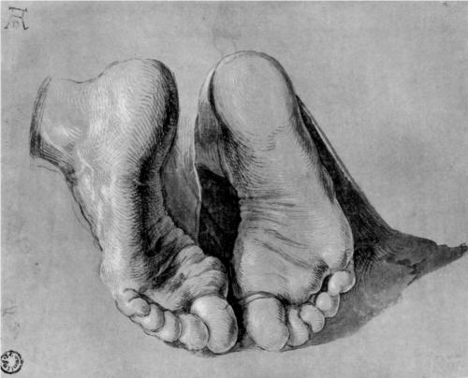
Albrecht Durer
Albrecht Durer was a German artist who helped spread Renaissance ideals into Northern Europe. He studied anatomy so he could paint people more realistically. He is most famous for his prints, which are reproductions of original works.

